Slide 1
UNIT 4: Association and Correlation analysis

Slide 2
Summary: What is Data Mining?
Data mining: semi-automatic discovery of interesting patterns from large data sets
Knowledge discovery is a process:
Preprocessing
Data mining
Postprocessing

Slide 3
Summary: Typical KDD Process
Time
based
selection
Operational
Database
Raw
data
Selection
Eval. of
interes-
tingness
Input data
Data mining
Results
Preprocessing
Postprocessing
Cleaned
Verified
Focused
2
Selection
1
3
Utilization
Selected
usable
patterns

Slide 4
Association Rules
Basics
Examples
Apriori Algorithm
FP Growth algorithm
Applications

Slide 5
Market Basket Analysis
This is the most typical example of association mining. Data is collected using barcode scanners in most supermarkets.
This database, known as the “market basket” database, consists of a large number of records on past transactions.
A single record lists all the items bought by a customer in one sale. Knowing which groups are inclined towards which set of items gives these shops the freedom to adjust the store layout and the store catalogue to place the optimally concerning one another.

Slide 6
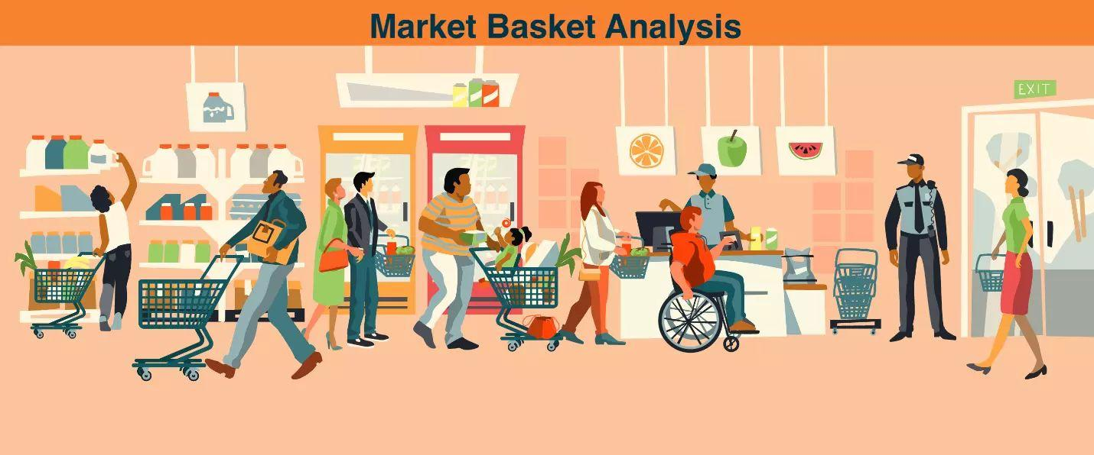
When people buy green tea, it is evident that they may also buy honey with it. This relationship is depicted as a conditional algorithm, as given below.
IF {green tea} THEN {honey}
It represents that items stated on the right are more likely to be ordered with the items on the left side. Market basket analysis in data mining helps us understand that relationship and how helpful it would be to alter our decisions based on the analysis.

Slide 7
Frequent Pattern
Frequent patterns are patterns that appear frequently in a data set. Patterns may be item sets, subsequence or substructures.
Example: A set of items, such as Milk & Butter that appear together in a transaction data set. ( Also called Frequent Item set).
• Frequent item set mining leads to the discovery of associations and correlations among items in large transactional (or) relational data sets.
• This helps in many business decision- making processes like Catalog design, and customer shopping behavior analysis, etc.

Slide 8
Association Rules: Basics
Typical representation formats for association rules:
Green Tea ⇒ Honey[0.5%, 60%]
buys: Green Tea ⇒ buys: Honey [0.5%, 60%]
Green Tea and Honey are bought together in 0.5% of the rows in the database."
"IF buys Green Tea , THEN buys Honey in 60% of the cases.

Slide 9
Association Rules: Basics
Green Tea ⇒ Honey [0.5%, 60%]
"IF buys Green Tea ,
THEN buys Honey
in 60% of the cases
in 0.5% of the rows"
1
2
3
4
Antecedent, left-hand side (LHS), body
Consequent, right-hand side (RHS), head
Support, frequency ("in how big part of the data the things in left- and right-hand sides occur together")
Confidence, strength ("if the left-hand side occurs, how likely the right-hand side occurs")

Slide 10
Association Rules: Basics
A=>B
Support: denotes probability that contains both A and B.
Confidence: denotes probability that a transaction containing A also contains B.

Slide 11
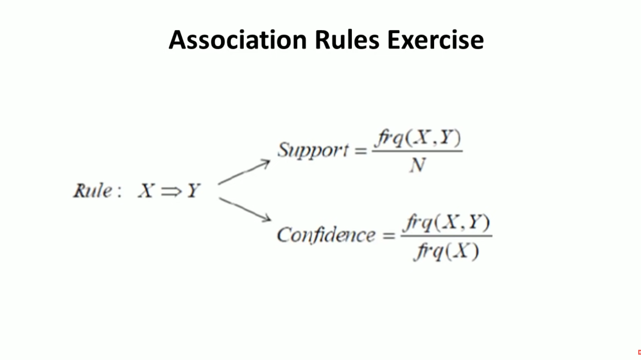

Slide 12
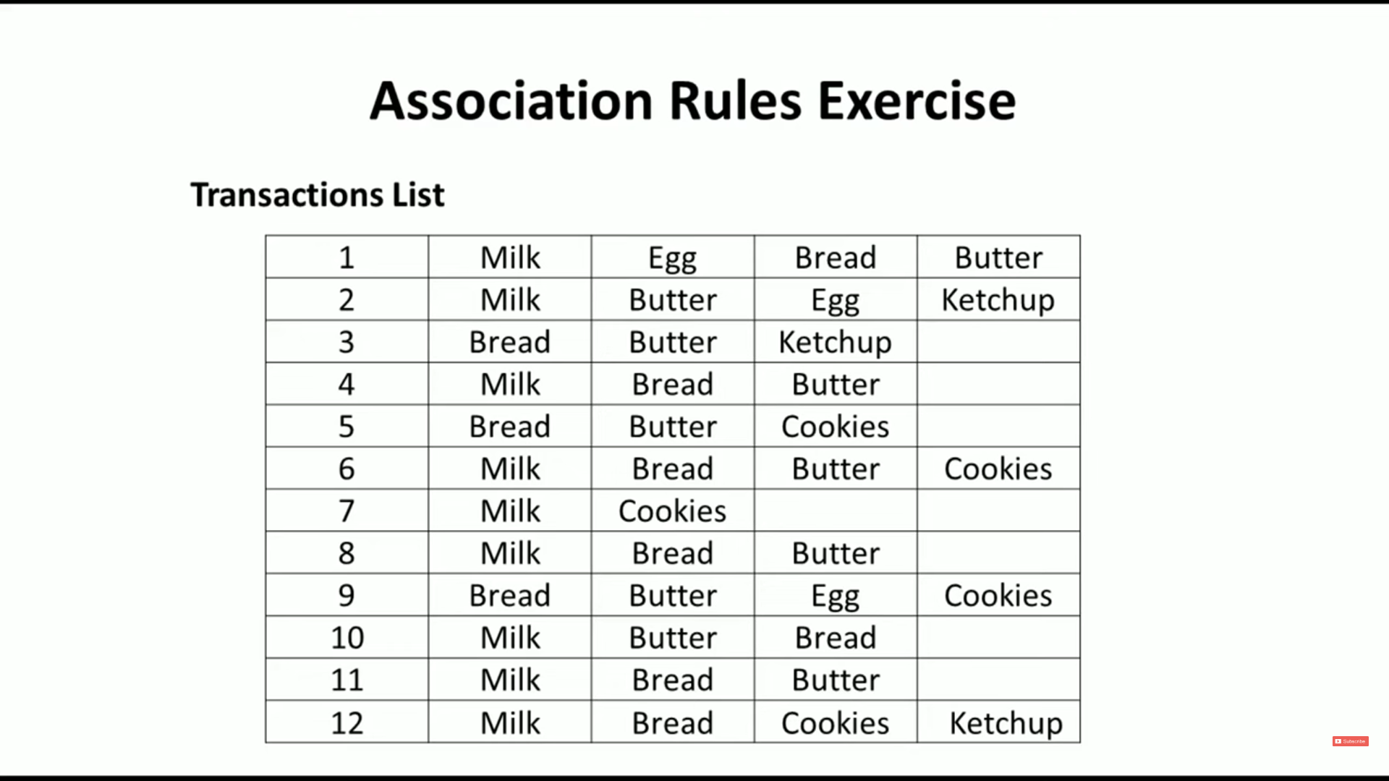

Slide 13
Apriori Algorithm
Apriori algorithm is given by R. Agrawal and R. Srikant in 1994 for finding frequent item sets in a dataset for Boolean association rule.
Name of the algorithm is Apriori because it uses prior knowledge of frequent itemset properties.
Apriori algorithm refers to the algorithm which is used to calculate the association rules between objects.
It means how two or more objects are related to one another. In other words, we can say that the Apriori algorithm is an association rule leaning that analyses that people who bought product A also bought product.

Slide 14
Apriori Algorithm
Method:
Initially, scan DB once to get frequent 1-itemset.
Generate length (k+1) candidate itemsets from length k frequent itemsets.
Test the MINIMUM SUPPORT.
Terminate when no frequent or candidate set can be generated

Slide 15
Apriori Algorithm
First, the set of frequent 1-itemsets is found by scanning the database to accumulate the count for each item, and collecting those items that satisfy minimum support. The resulting set is denoted by L1.
Next, L1 is used to find L2 , the set of frequent 2-itemsets, which is used to find L3, and so on, until no more frequent k-itemsets can be found. The finding of each Lk requires one full scan of the database.

Slide 16
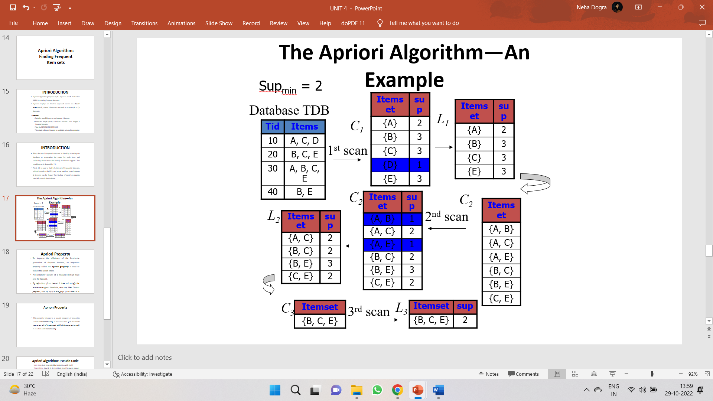
Apriori Algorithm

Slide 17
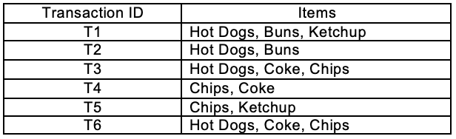
Apriori Algorithm – Example 2
Find the frequent itemsets and generate association rules on this. Assume that minimum support threshold (s = 33.33%) and minimum confident threshold (c = 60%)

Slide 18
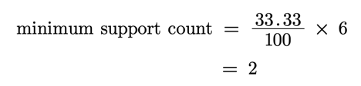
Apriori Algorithm – Example 2
Let’s start,

Slide 19
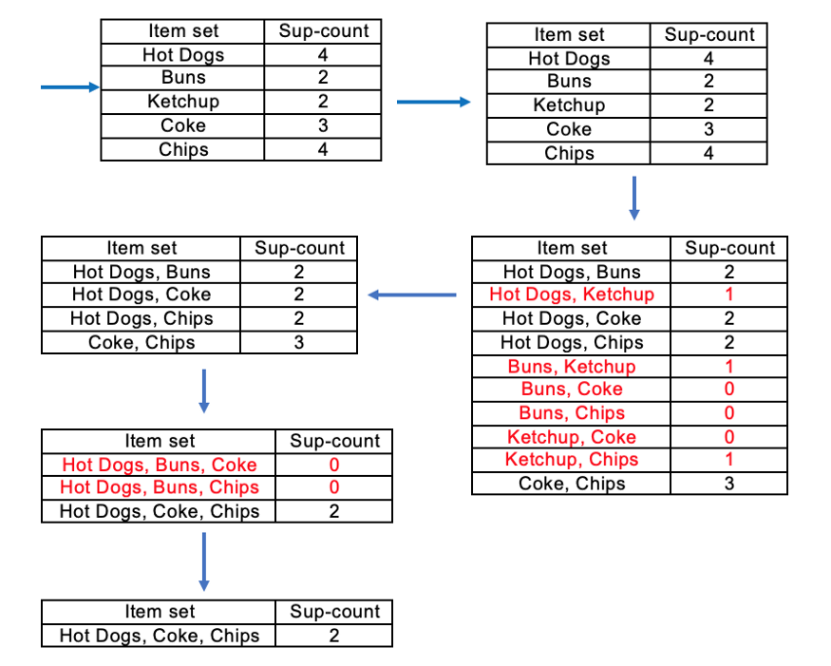
There is only one itemset with minimum support 2. So only one itemset is frequent.

Slide 20
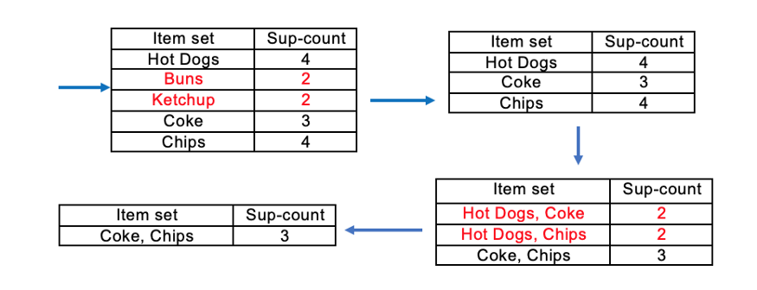
Same example with minimum support =3
Frequent Itemset (I) = {Coke, Chips}

Slide 21
Apriori Algorithm
Advantages of Apriori Algorithm
It is used to calculate large item sets.
Simple to understand and apply.
Disadvantages of Apriori Algorithms
Apriori algorithm is an expensive method to find support since the calculation has to pass through the whole database.
Sometimes, you need a huge number of candidate rules, so it becomes computationally more expensive.

Slide 22
Bottleneck of Frequent-pattern Mining
Multiple database scans are costly
Mining long patterns needs many passes of scanning and generates lots of candidates
To find frequent itemset i₁i₂…i₁₀₀
# of scans: 100
Bottleneck: candidate-generation-and-test
Can we avoid candidate generation?

Slide 23
What is FP Growth Algorithm?
The FP-Growth Algorithm is an alternative way to find frequent item sets without using candidate generations, thus improving performance.
For so much, it uses a divide-and-conquer strategy. The core of this method is the usage of a special data structure named frequent-pattern tree (FP-tree), which retains the item set association information.

Slide 24
Process of FP growth
FP-Growth: allows frequent itemset discovery without candidate itemset generation. Two step approach:
Step 1: Build a compact data structure called the FP-tree
Built using 2 passes over the data-set.
Step 2: Extracts frequent itemsets directly from the FP-tree

Slide 25
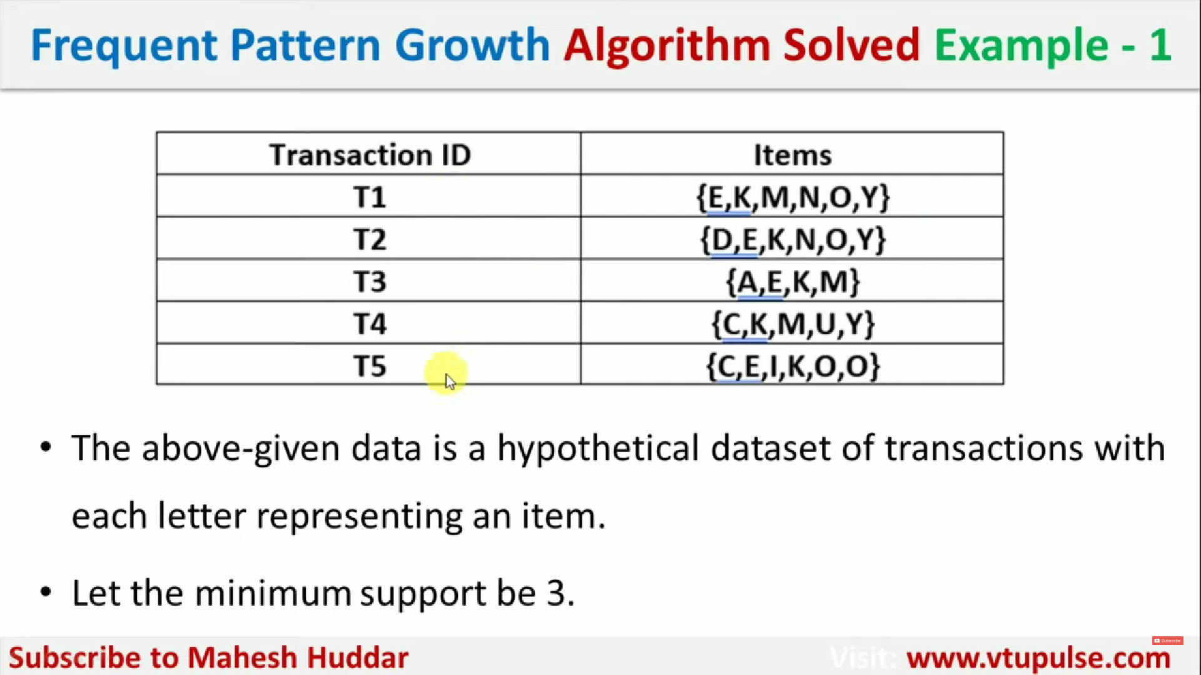

Slide 26
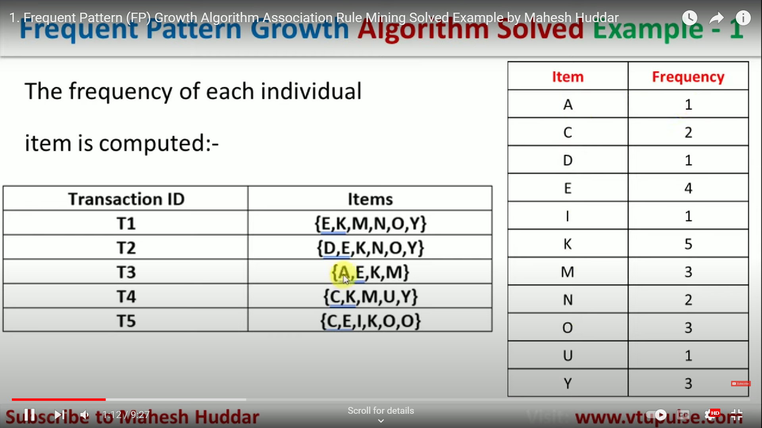

Slide 27
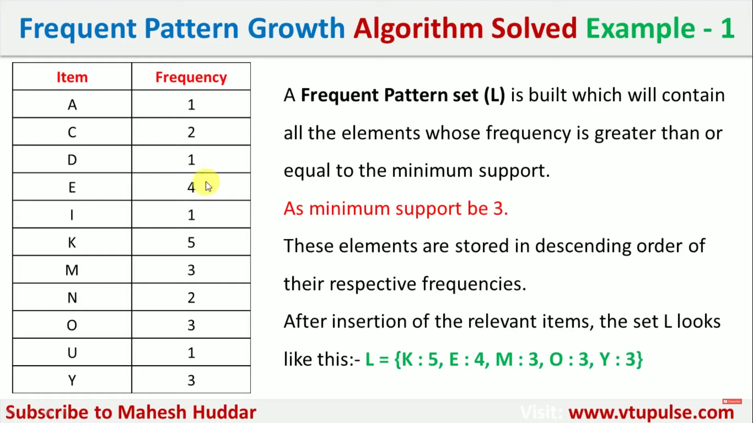

Slide 28
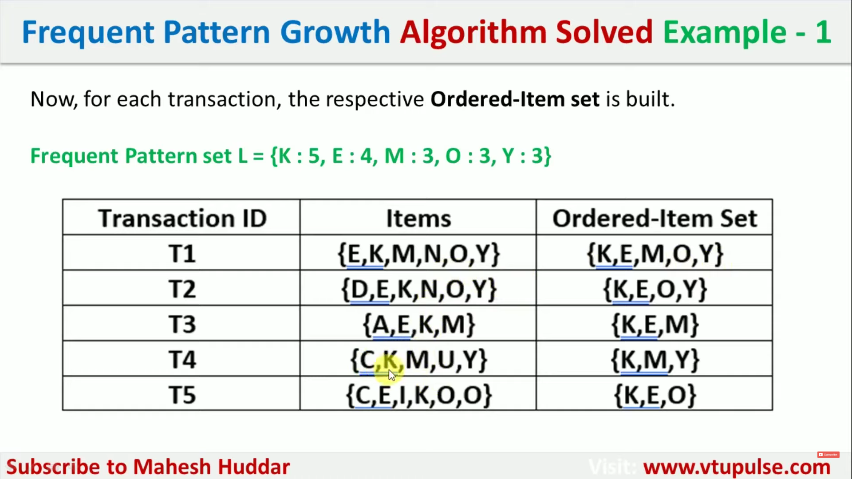

Slide 29
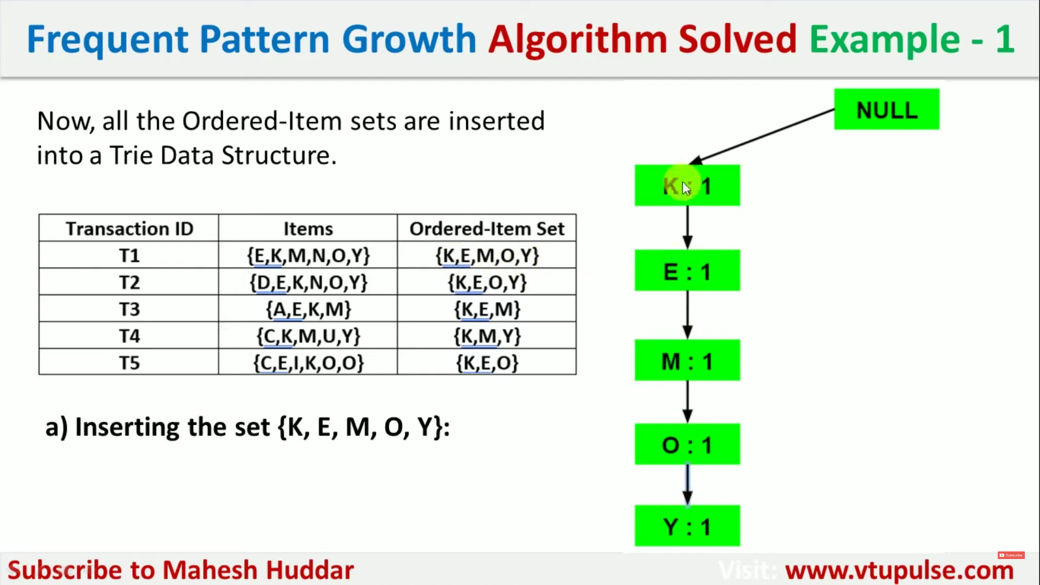

Slide 30
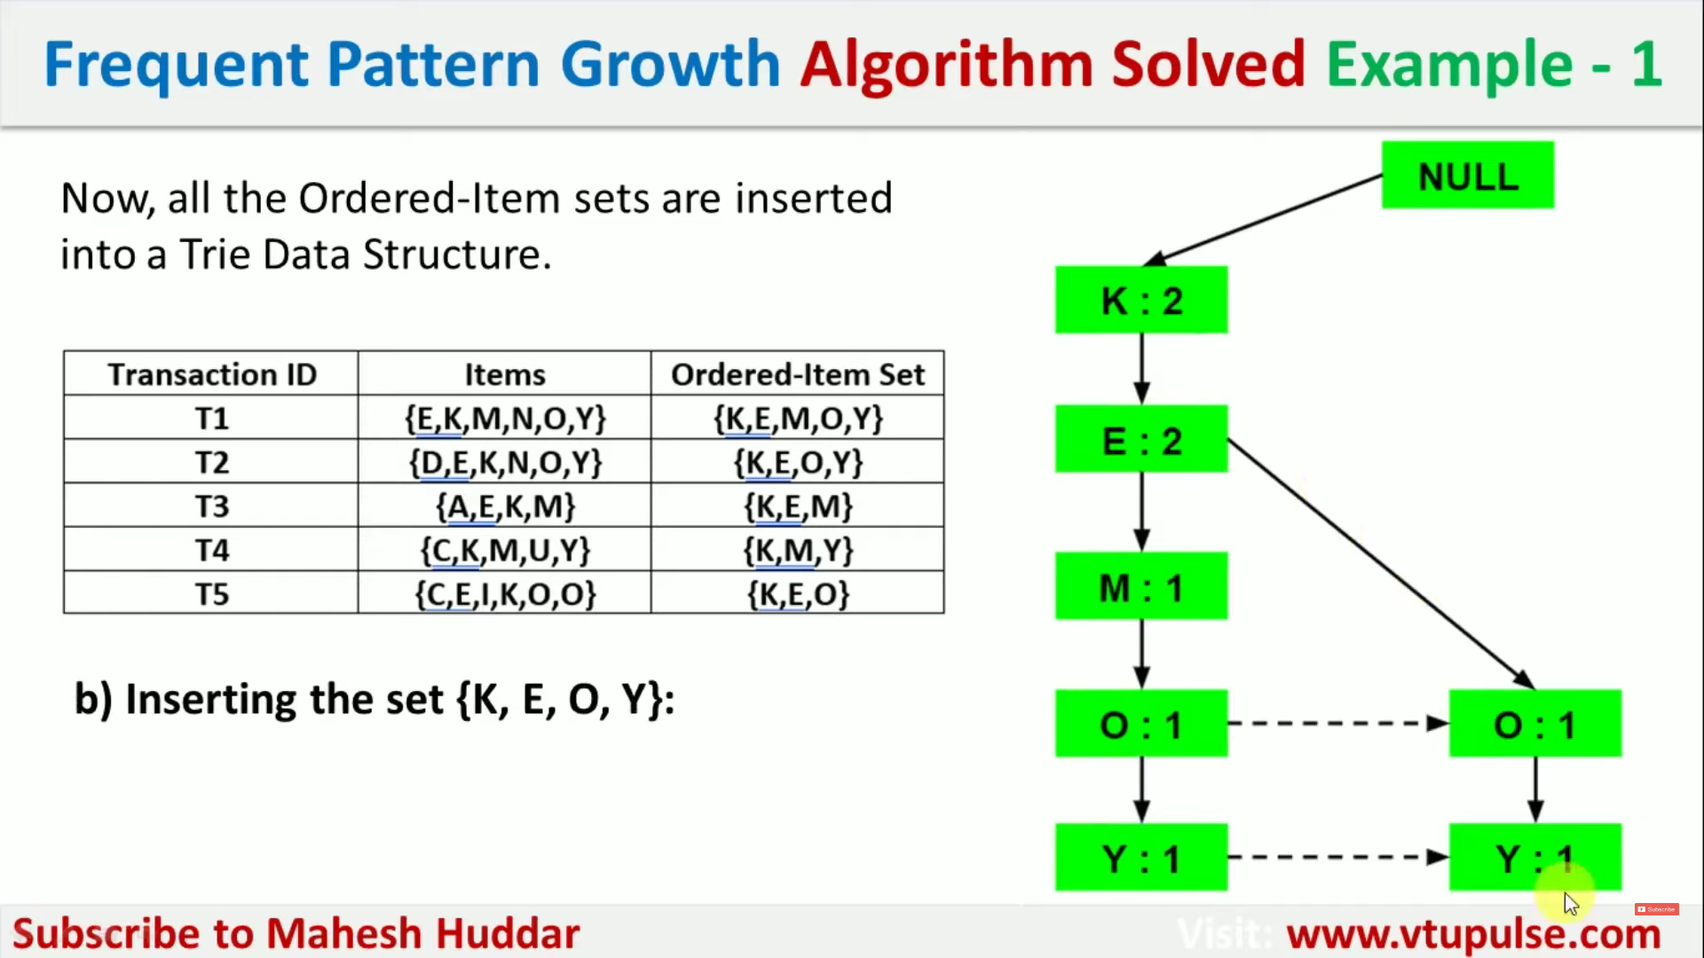

Slide 31
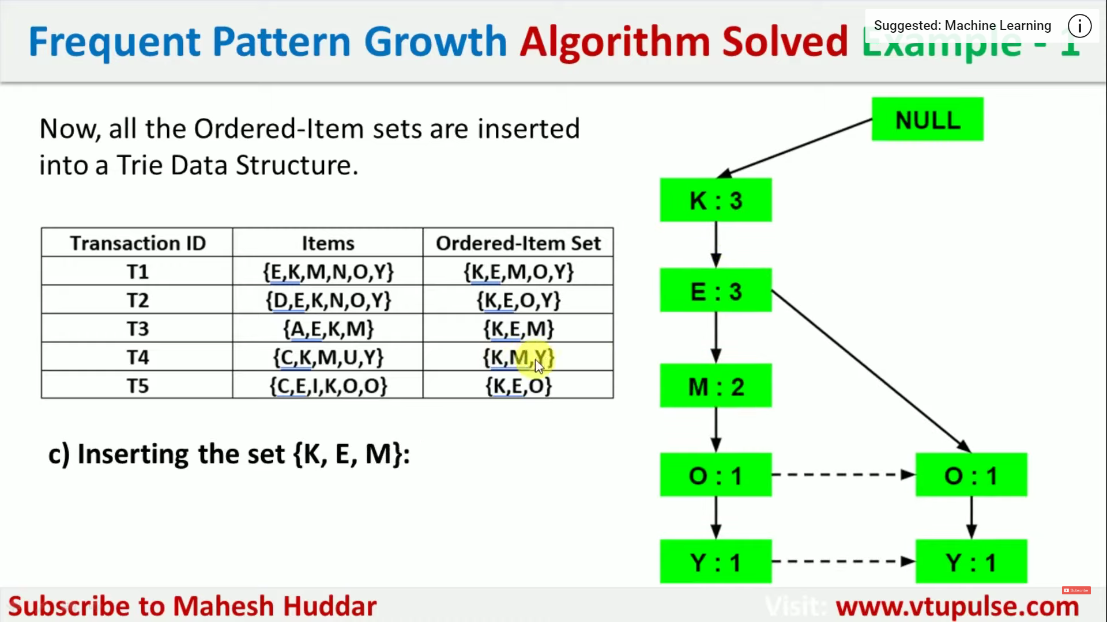

Slide 32
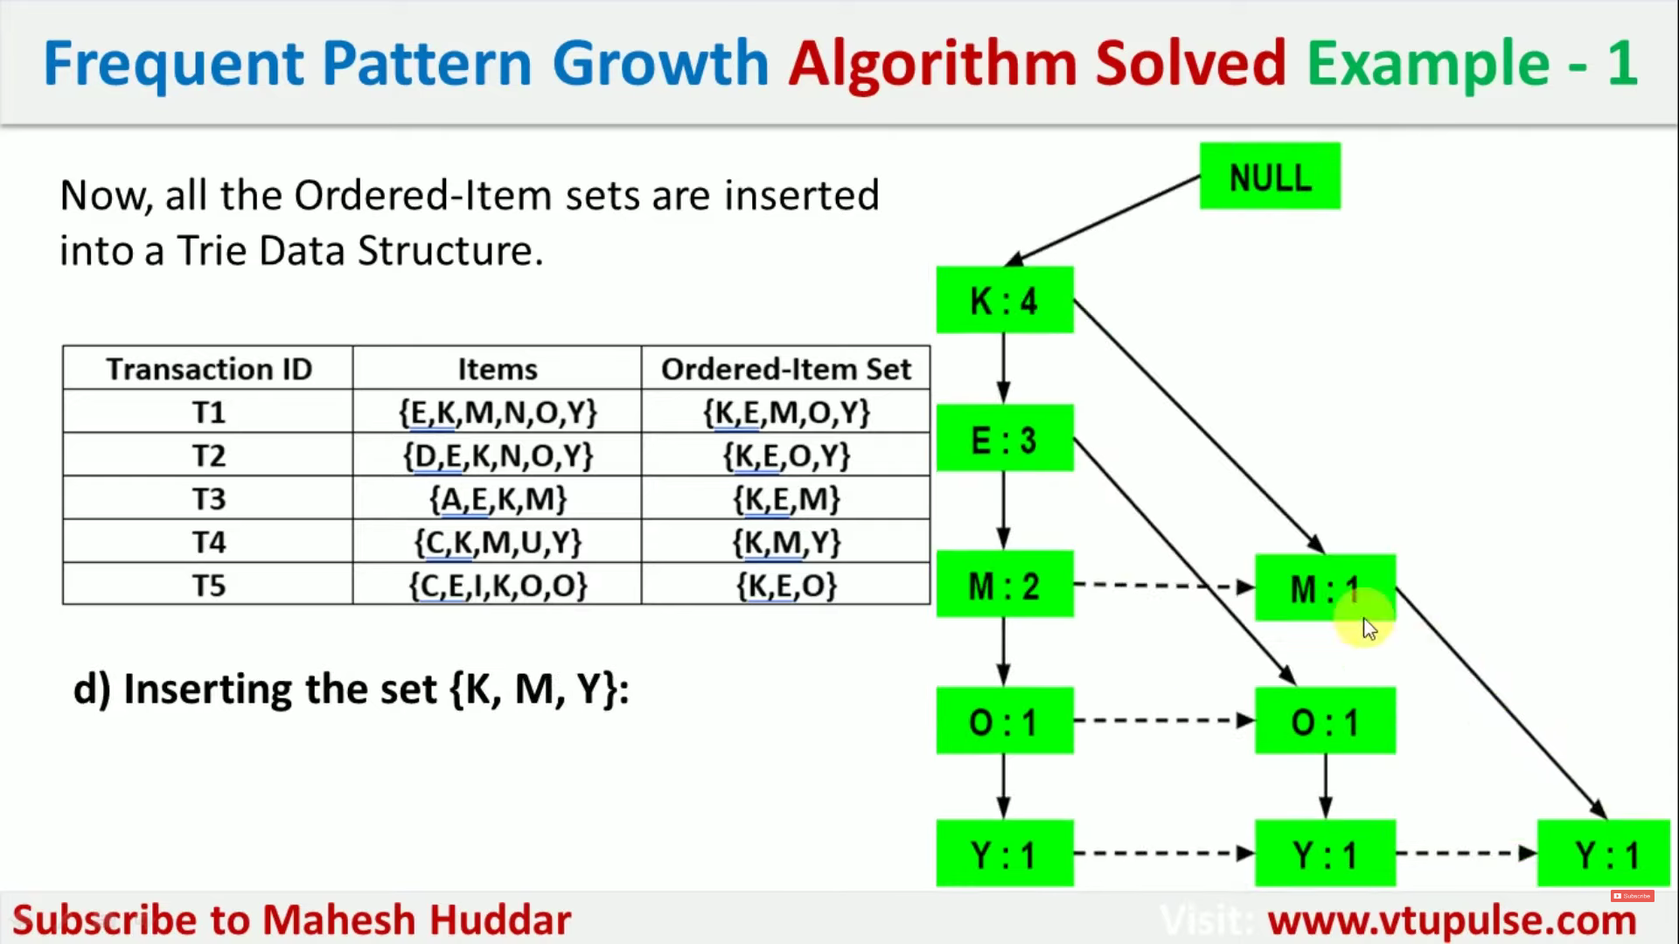

Slide 33
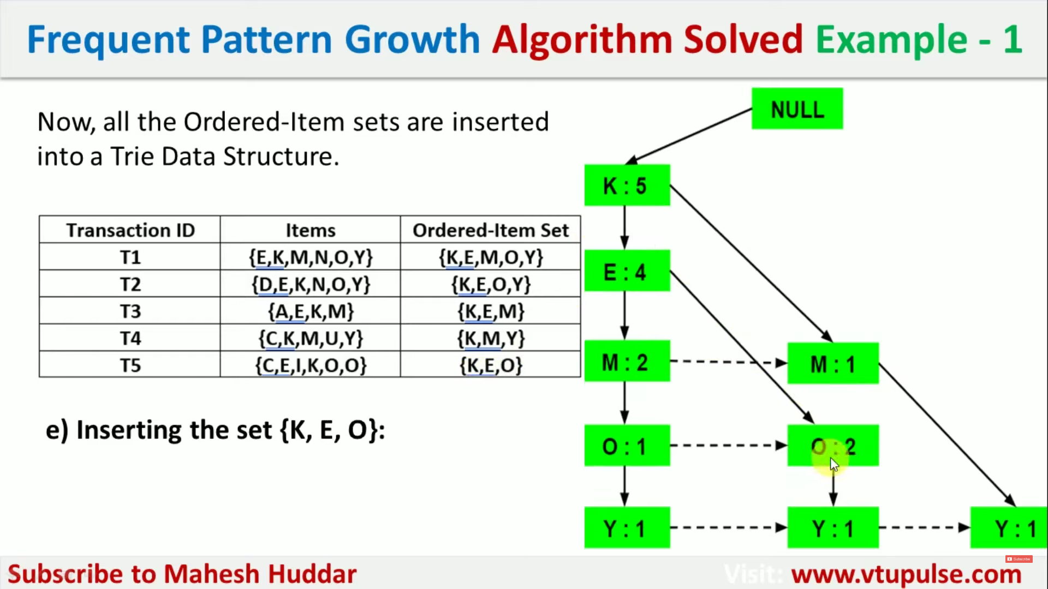

Slide 34
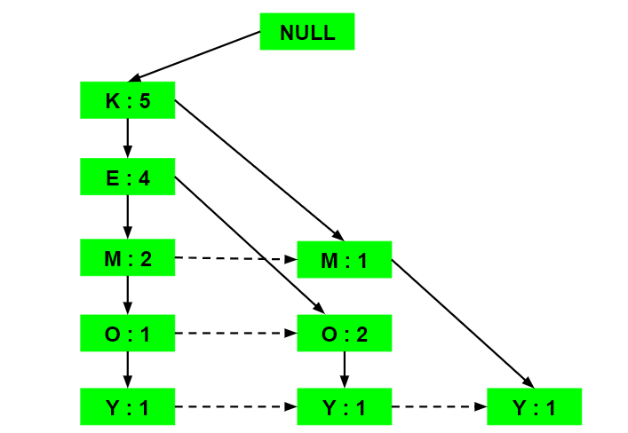
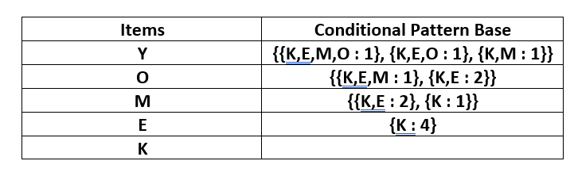
Now, for each item, the Conditional Pattern Base is computed which is path labels of all the paths which lead to any node of the given item in the frequent-pattern tree. Note that the items in the below table are arranged in the ascending order of their frequencies.

Slide 35
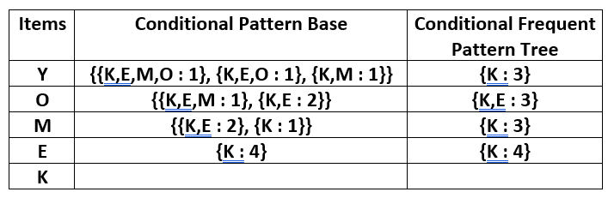
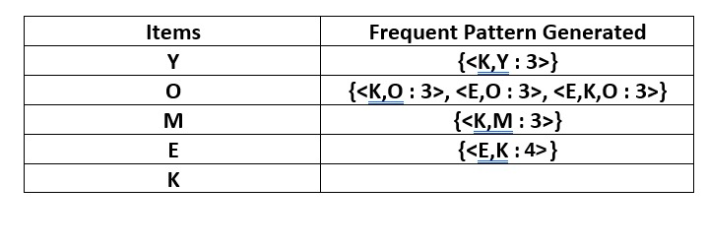
Now for each item, the Conditional Frequent Pattern Tree is built. It is done by taking the set of elements that is common in all the paths in the Conditional Pattern Base of that item and calculating its support count by summing the support counts of all the paths in the Conditional Pattern Base.

Slide 36
From the Conditional Frequent Pattern tree, the Frequent Pattern rules are generated by pairing the items of the Conditional Frequent Pattern Tree set to the corresponding to the item as given in the below table.

Slide 37
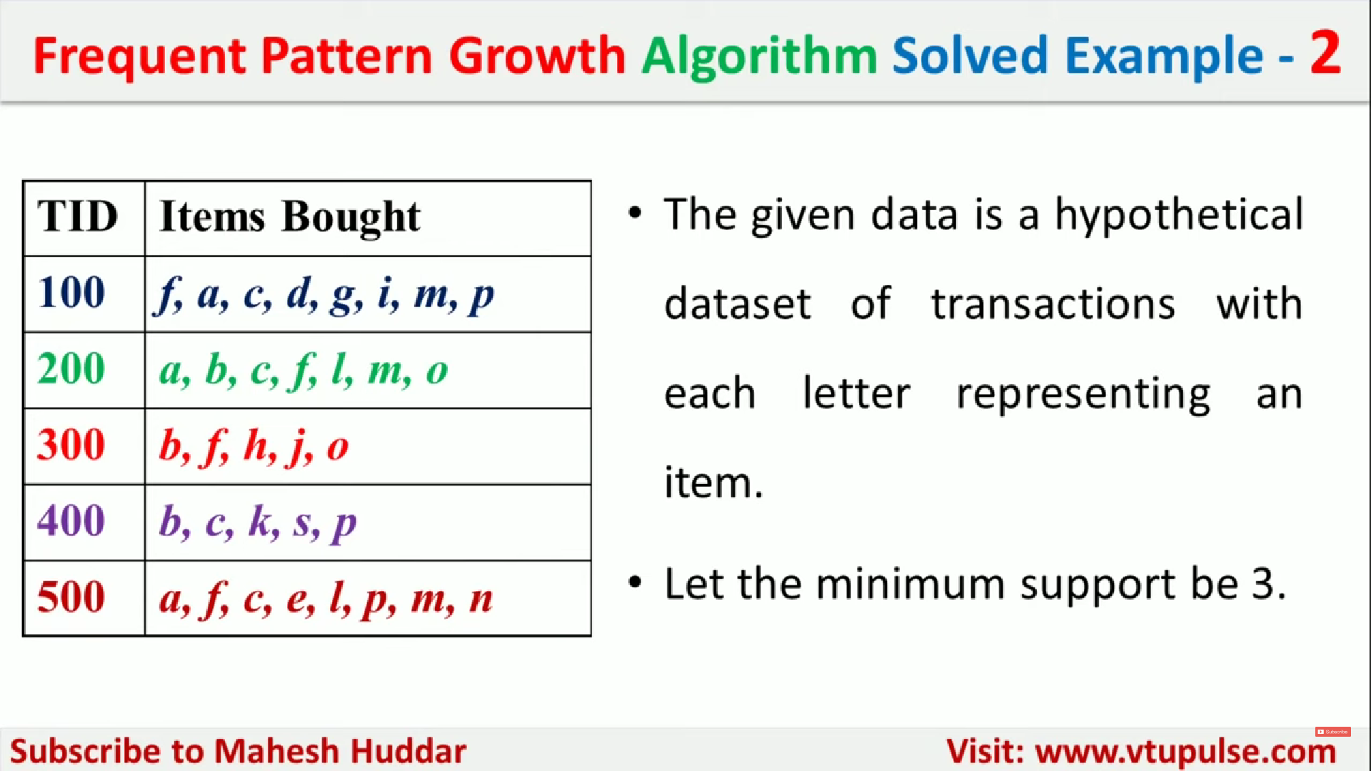

Slide 38
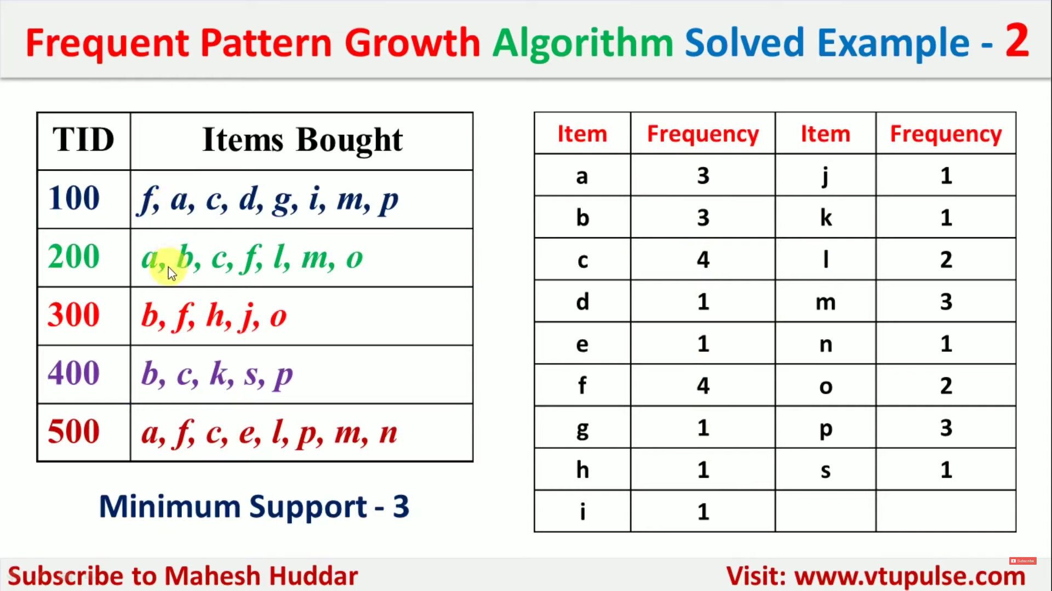

Slide 39
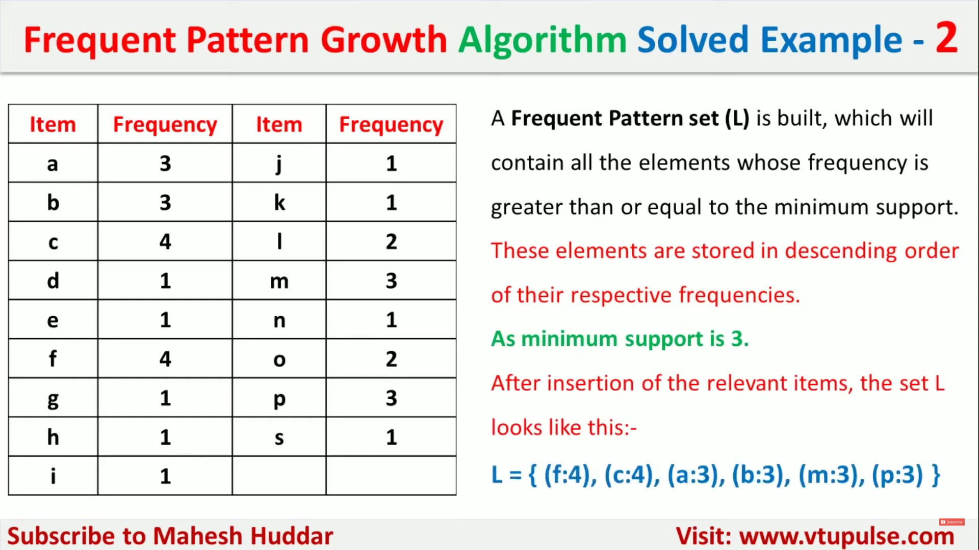

Slide 40
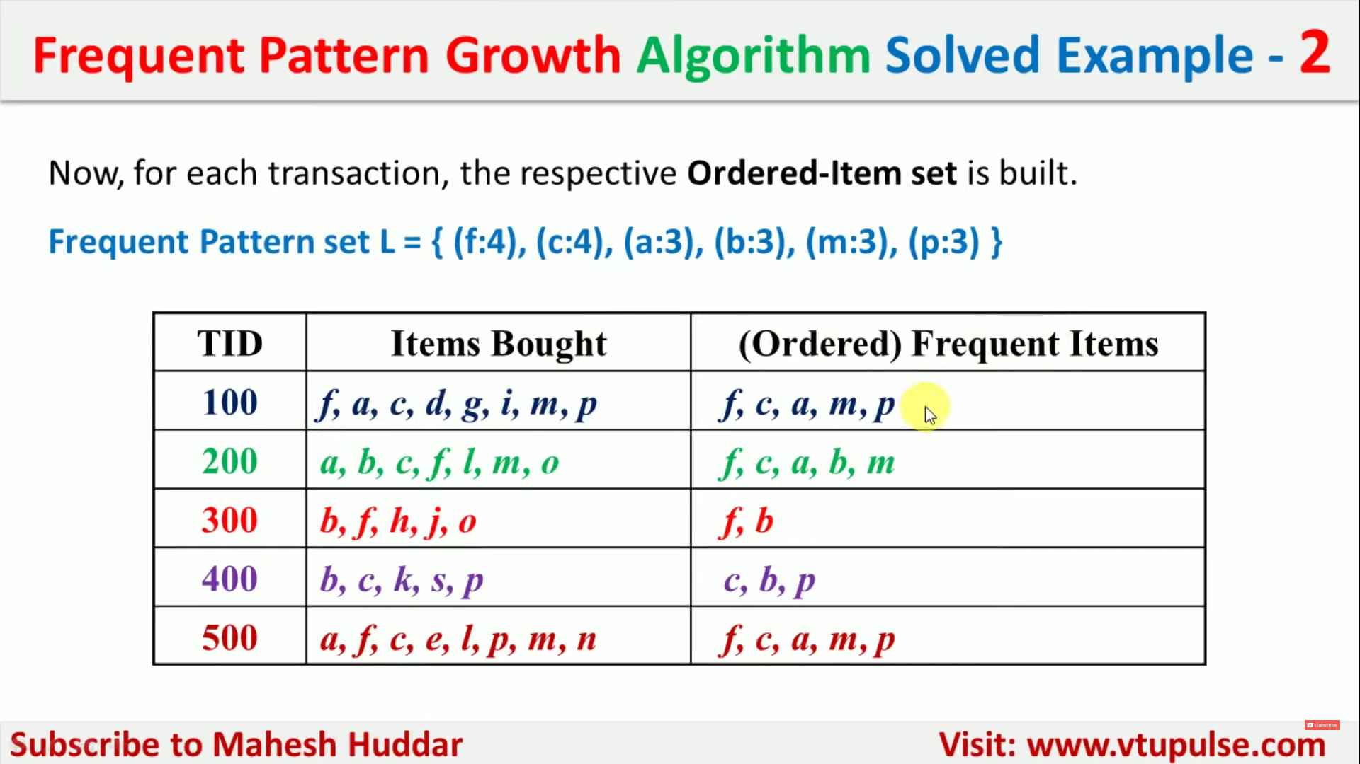

Slide 41
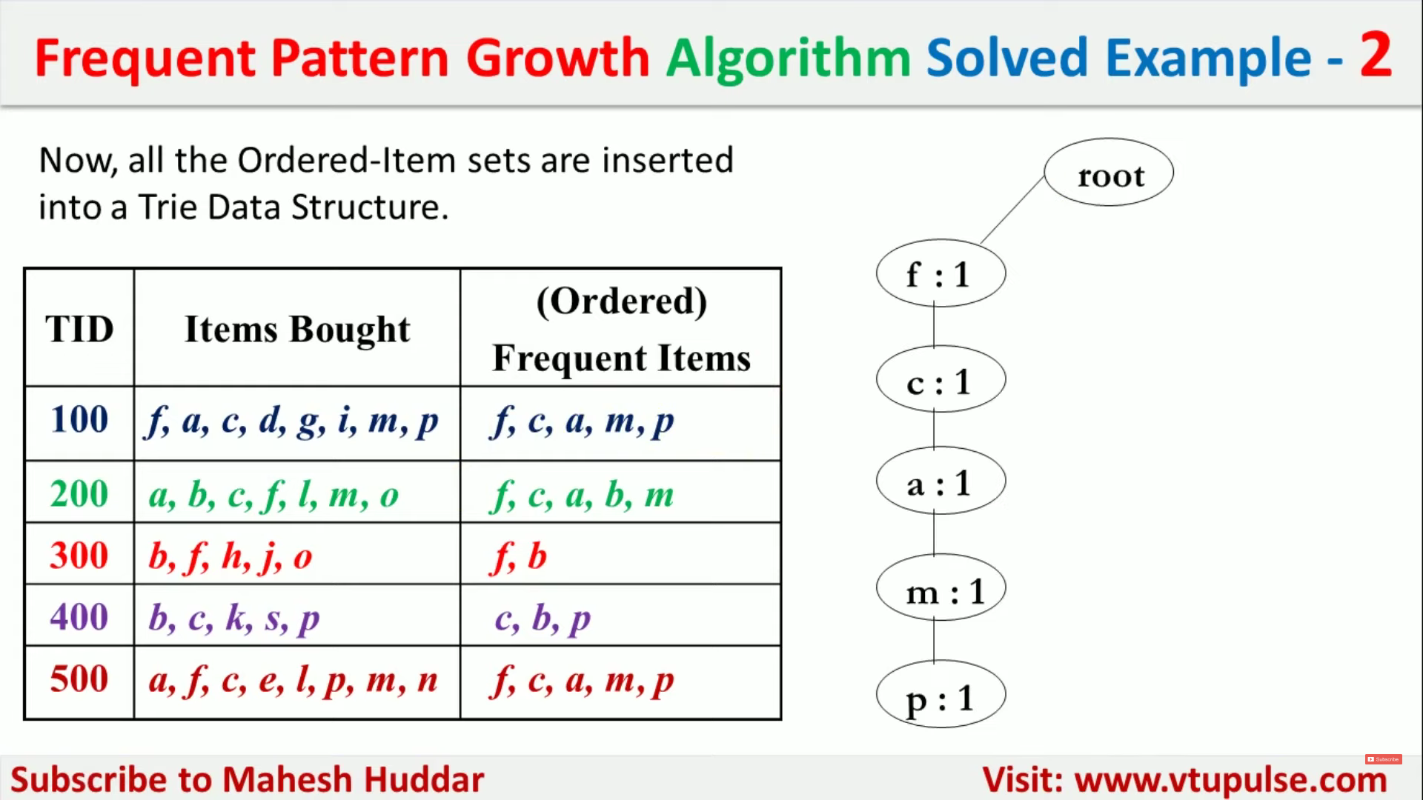

Slide 42
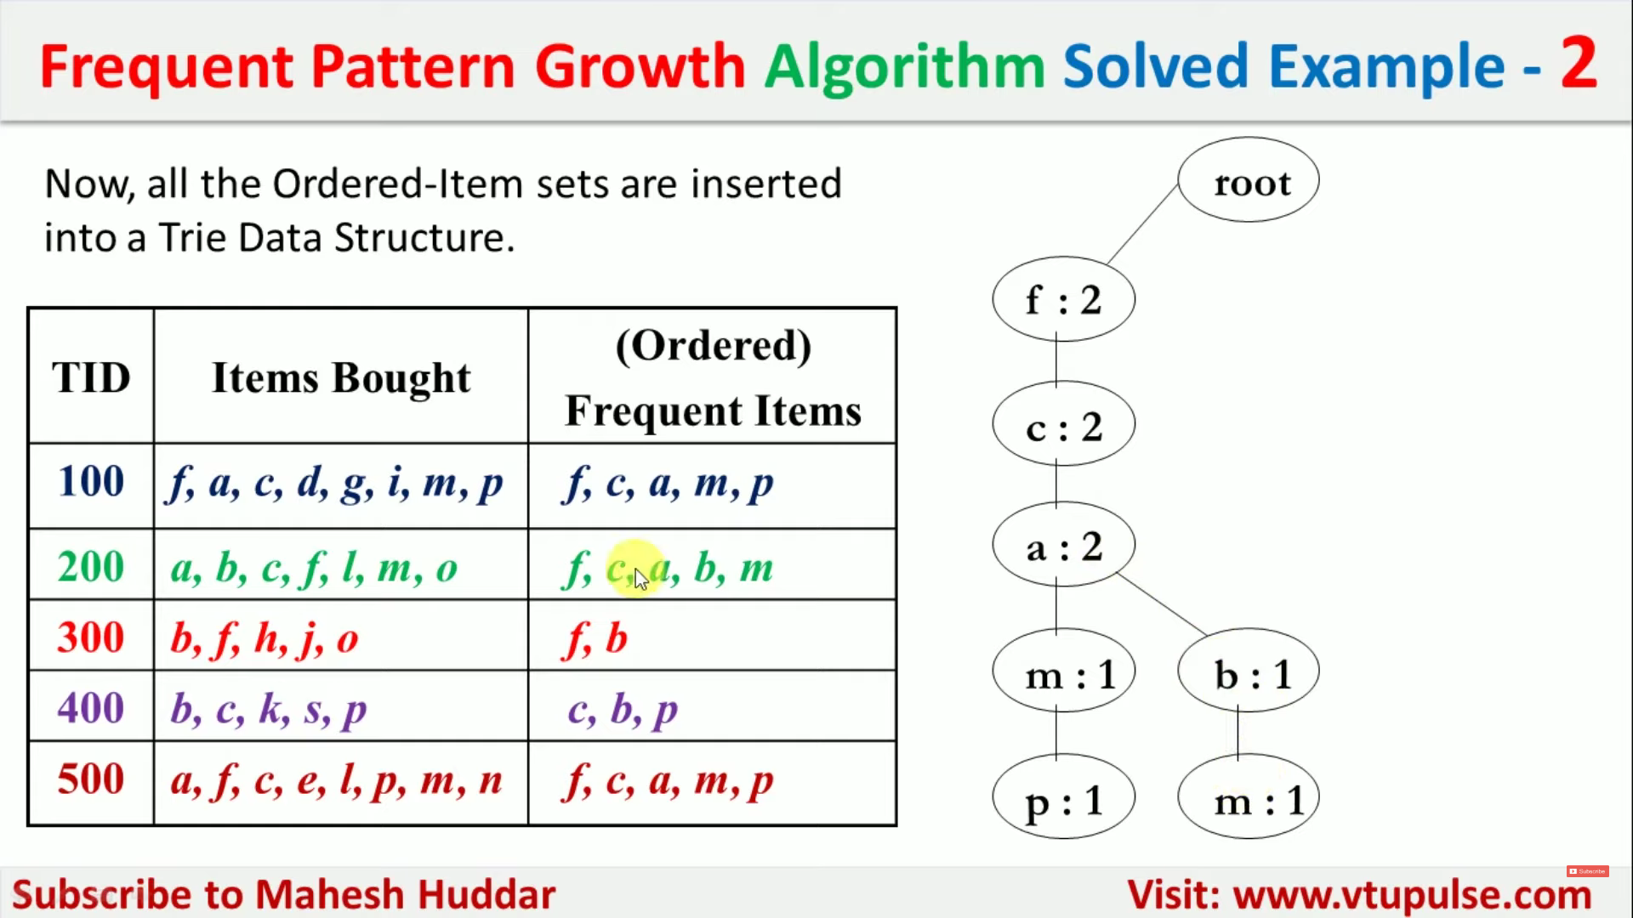

Slide 43
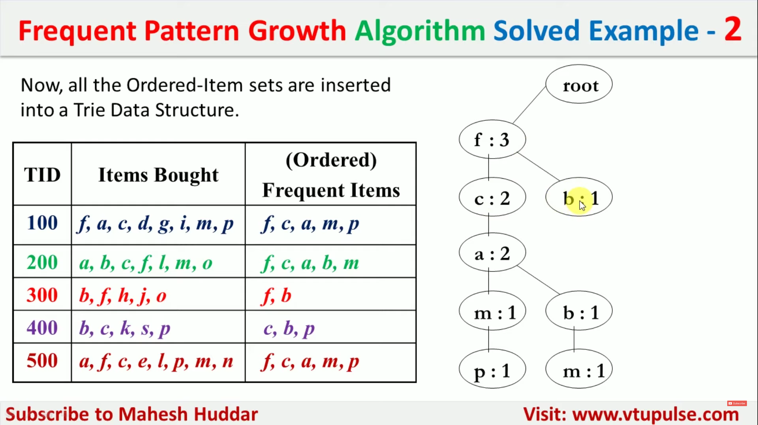

Slide 44
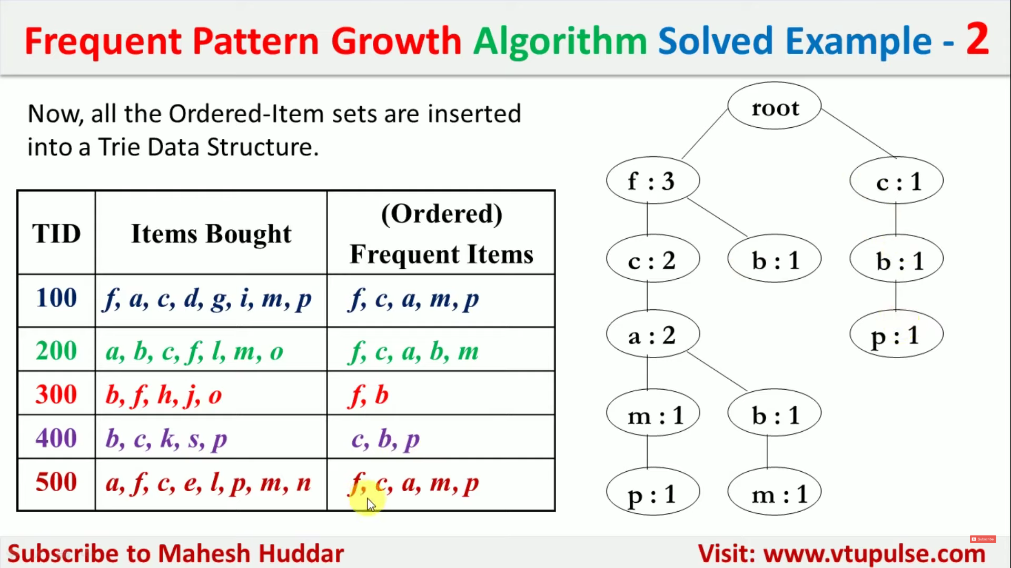

Slide 45
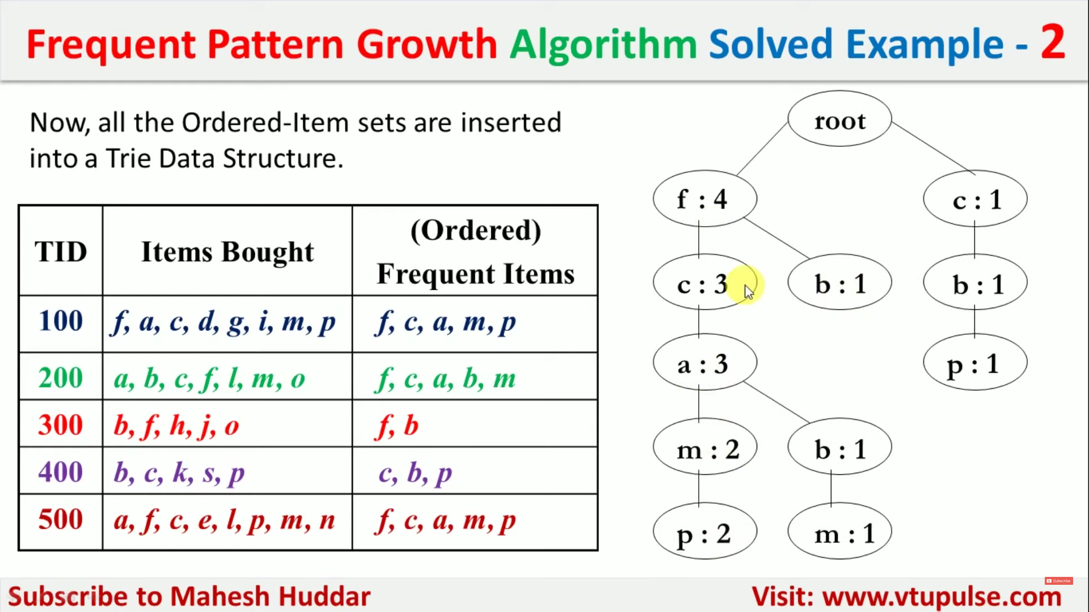

Slide 46
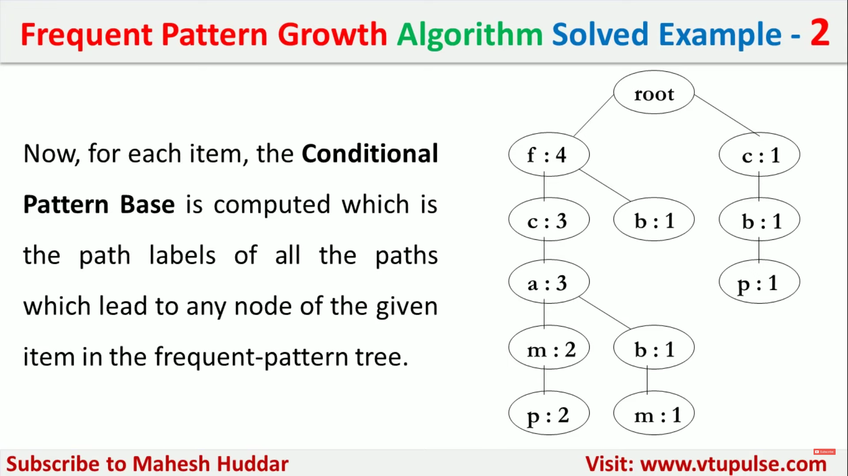

Slide 47
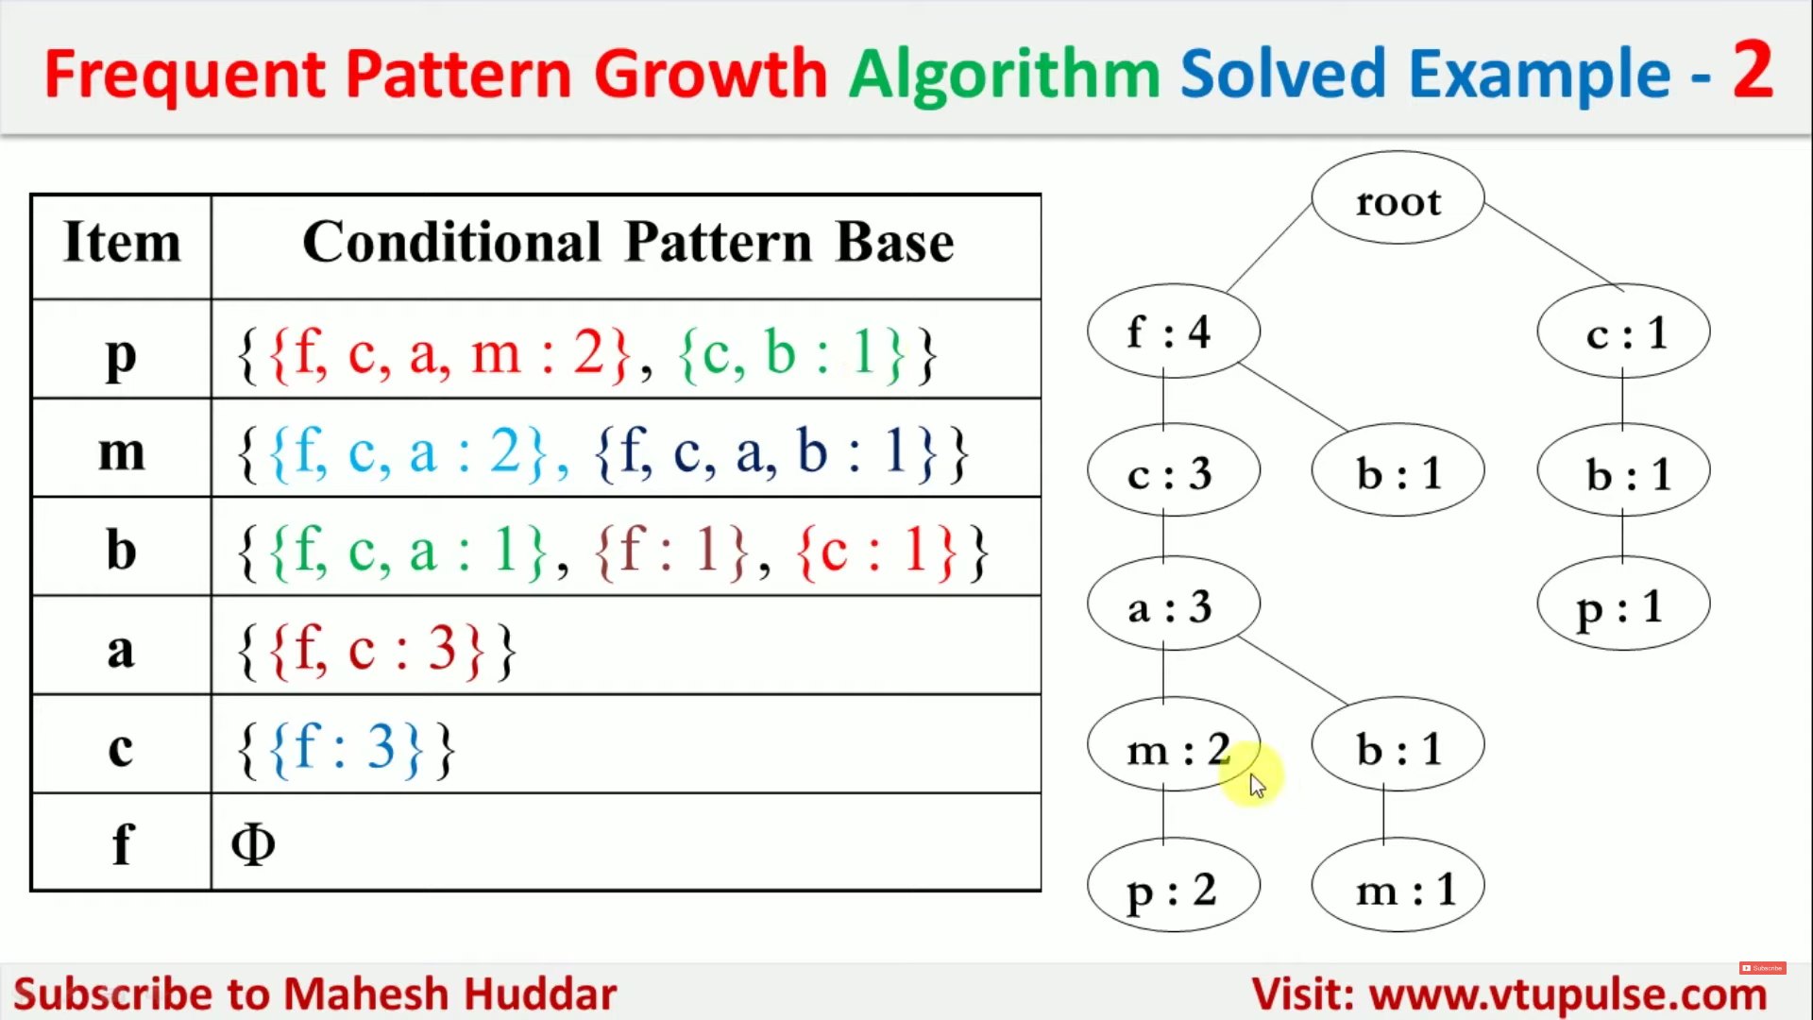

Slide 48
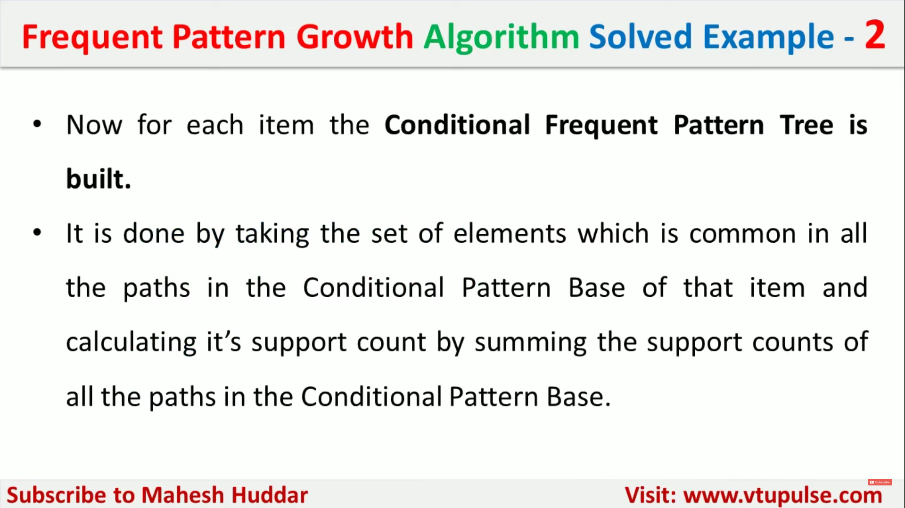

Slide 49
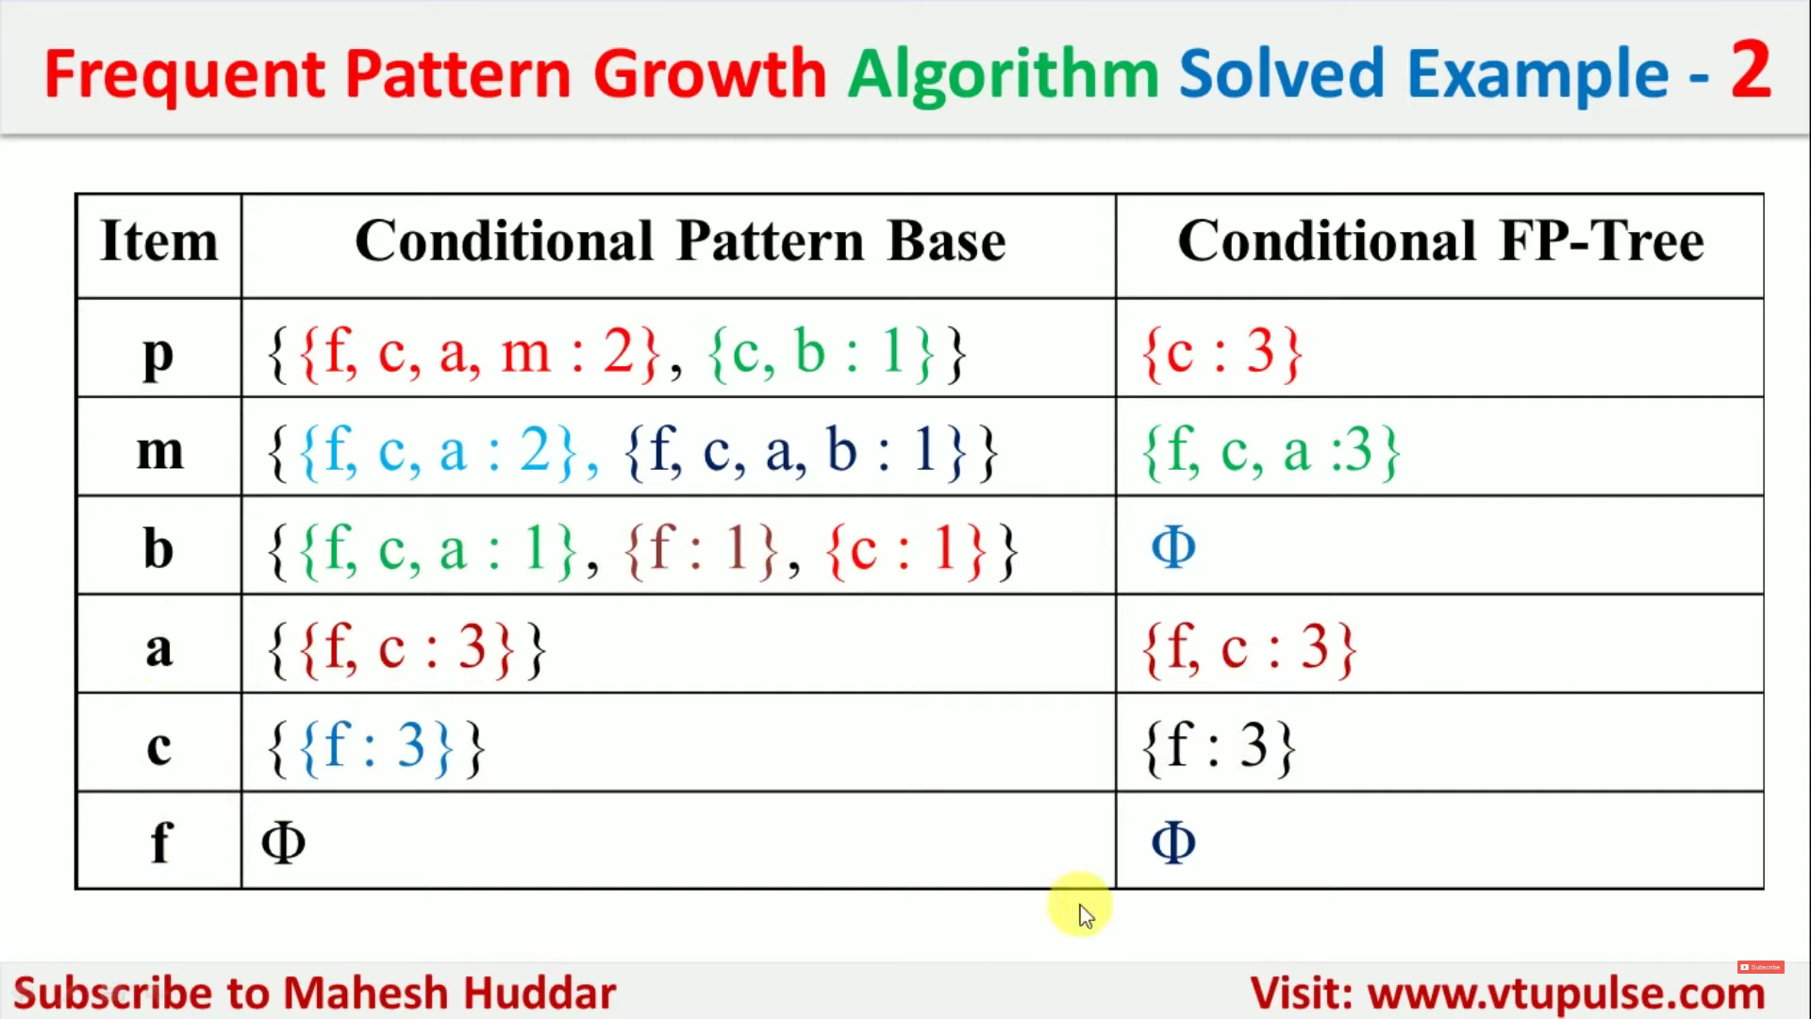

Slide 50
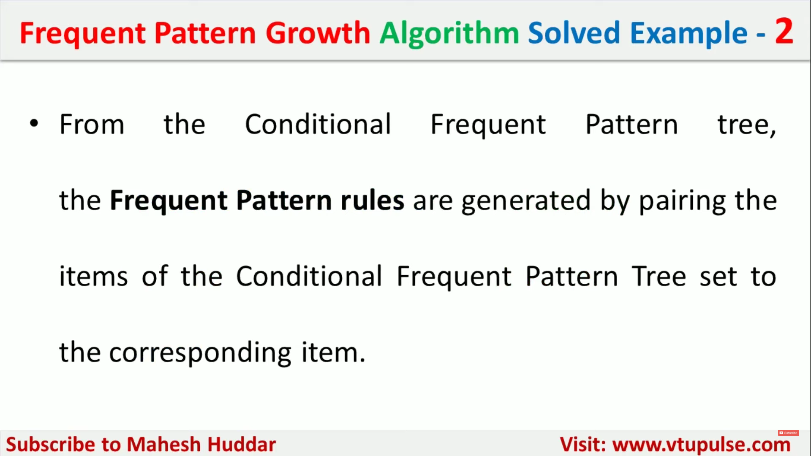

Slide 51
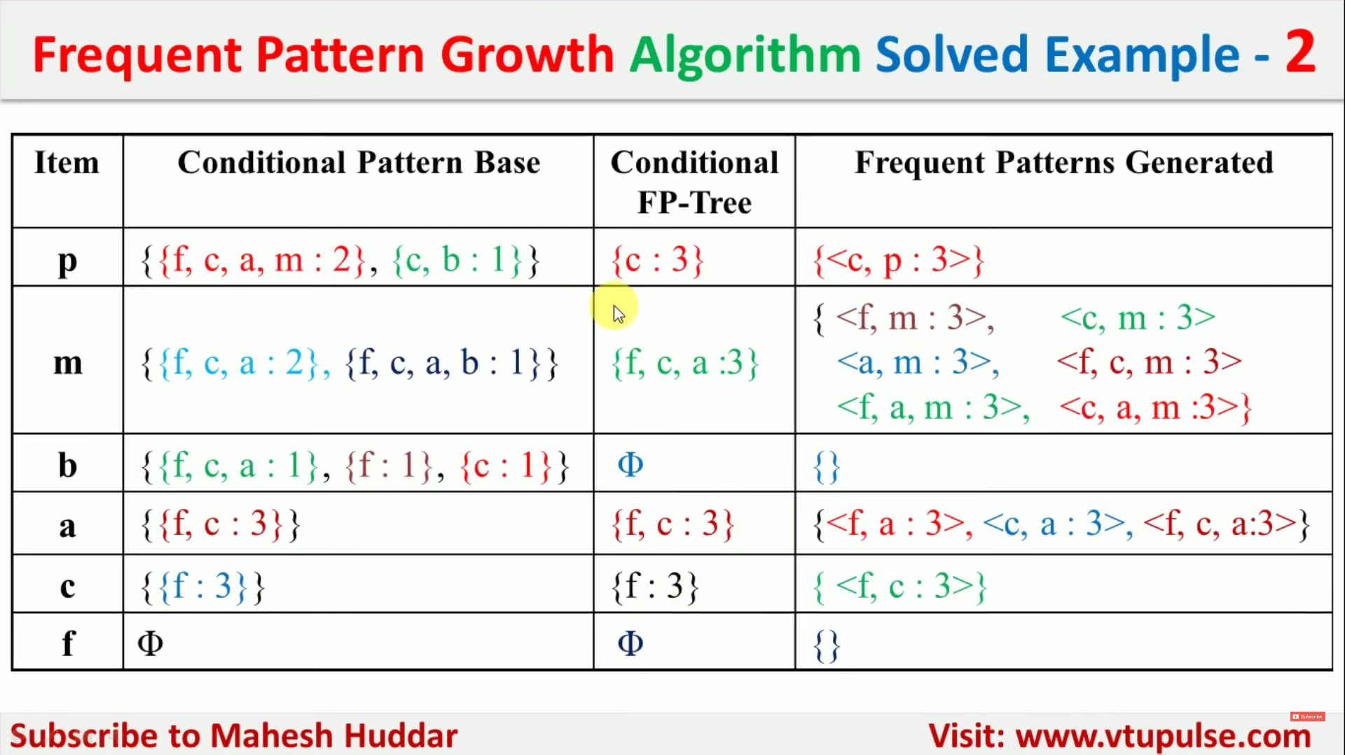

Slide 52
Applications of Association Rules
Association rule learning is a type of unsupervised learning methods that tests for the dependence of one data element on another data element and create appropriately so that it can be more effective.
It tries to discover some interesting relations or relations among the variables of the dataset. It depends on several rules to find interesting relations between variables in the database.

Slide 53
Applications of Association Rules
There are various applications of Association Rule which are as follows −
Items purchased on a credit card, such as rental cars and hotel rooms, support insight into the following product that customer are likely to buy.
Optional services purchased by tele-connection users (call waiting, call forwarding, DSL, speed call, etc.) support decide how to bundle these functions to maximize revenue.
Banking services used by retail users (money industry accounts, CDs, investment services, car loans, etc.) recognize users likely to needed other services.
Unusual group of insurance claims can be an expression of fraud and can spark higher investigation.
Medical patient histories can supports expressions of likely complications based on definite set of treatments.

